Slide 1
Data Analysis of U.S. Manufacturing Sector
Abdull Algahtani, Alex Mejia, Taj Mahal, and Thomas McCann

Slide 2
Goal of this Data
Number of Employment
Labor Productivity and Costs
U.S. Manufacturing Sector
Wages
Occupational Growth
Notes:
In the U.S. Manufacture sector we are going to examine the following elements:
Labor Productivity and Costs
Number of Employment
Wages
Occupational Growth

Slide 3
Why We Picked the Manufacturing Sector
Americans live in a global economy in which manufacturing is a large factor
Strong domestic manufacturing means protection from international tensions
Majority of technological research and innovation occurs in the manufacturing sector
Manufacturing occupation job loss impacts many American communities
Notes:
Americans live in a global economy in which manufacturing is a large factor
We have strong domestic manufacturing, what that means is that we are protected from international tension
Majority of technological research and innovation occurs in the manufacturing sector
Manufacturing occupation job loss impacts many American communities

Slide 4
Questions
In the US Manufacturing sector, how has technology impacted...
Labor productivity and labor costs?
Employment numbers?
Wage growth?
Occupational growth?
Notes:
We are trying to answer the following questions:
In the US Manufacturing sector, how has technology impacted..
Labor productivity and labor costs
Employment Number
Wage Growth
Occupational Growth.

Slide 5
Data Cleansing
Excel CSV file data cleaning was common amongst group
Concat multiple CSV files
Cleaning the API data from the bureau of labor statistics.
Update the loop function
Combining multiple Data Frames to get the total employments
Converting columns type into numeric for graphing.
Notes:
Excel CSV file data cleaning was common amongst the group
Merge multiple CSV files
Cleaning the API data from the bureau of labor statistics.
Update the loop function
Combining multiple Data Frames to get the total employments
Converting columns type into numeric for graphing.

Slide 6
Problems We Ran Into
Finding appropriate datasets to answer our questions
Cleaning the API Data from the Bureau Of Labor Statistics
Tying data values into percent changes to depict a correlation
Extracting sub data from a report to serve the purpose of our analysis
Notes:
Finding appropriate datasets to answer our questions
Cleaning the API Data from the Bureau Of Labor Statistics
Tying data values into percent changes to depict a correlation
Extracting sub data from a report to serve the purpose of our analysis

Slide 7
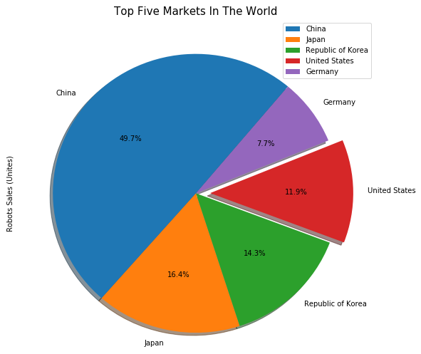
Global Industrial Robots Sales
Top five markets in the world:
China
Japan
Republic of Korea
United States
Germany
Notes:
*In order to answer our questions, we needed to find a way in how we can measure technology. Therefore we decided to use number of Industrial Robots sold to the U.S. Manufacture in the past 10 years.
*According to the International Federation of Robots, USA is the top five of industrial robots consumption.

Slide 8
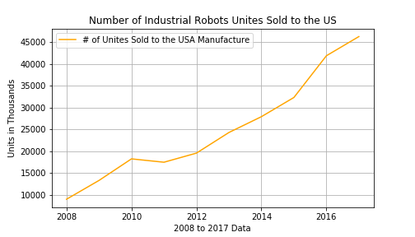
Units of Industrial Robots sold to the USA
Notes:
As we can see from the graph the number of industrial Robots have been sold to the USA have been increased the past 10 years. Which is indicate that the number of Automation has increased.

Slide 9
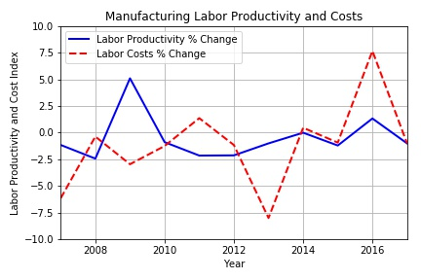
Manufacturing Labor Productivity and Costs
Data:
- Bureau of Labor Statistics: Major Sector Productivity and Costs
Method:
- CSV
- Pandas/Python
-Matplotlib
Analysis:
- Negative correlation in post recession years, transition to positive correlation during economic recovery
Conclusion:
- Ultimately the fluctuating productivity and labor costs have shown no significant impact on robot prices

Slide 10
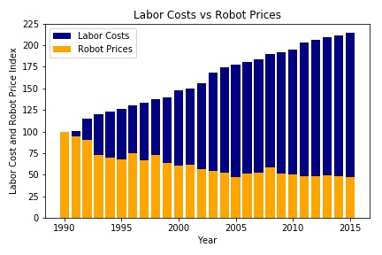
Labor Costs vs Robot Prices
Data:
- Manual data collected from McKinsey research report
Method:
- Pandas/Python
- Matplotlib
Analysis:
- As Labor costs increased, Robot prices decreased
Conclusion:
- As labor costs increased, robot demand increased driving their costs down

Slide 11
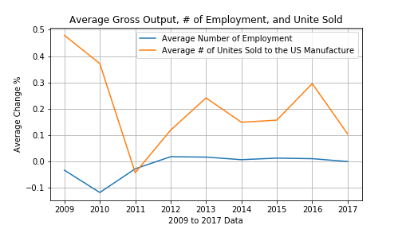
Impact of Technology on the Employment number (Manufacture sector) in the USA
Data:
- Bureau Of Labor Statistics: Employment number in the Manufacture sector in United States
- International Federation of Robotics: Industrial robot sales in the USA
Method:
- API
- CSV
Analysis:
- Determining the average # of employment and the average # of units sold to the USA Manufacture.
Conclusion:
- Even though the average # of units sold has increased in the past few years, the # of employment has not seen significant change.
Notes:
Analysis:
In order to compare between the # unites sold and # of employment , i had to get the average # of both data.

Slide 12
Has Automation Impacted Wages?
Labor force costs are increasing and the cost of automation is gradually decreasing with innovations.
Influence of automation in the Manufacturing Industry.
Manufacturers are incentivized to automate in an effort to lower cost.
How has this influence affected wages relative to other industries?

Slide 13
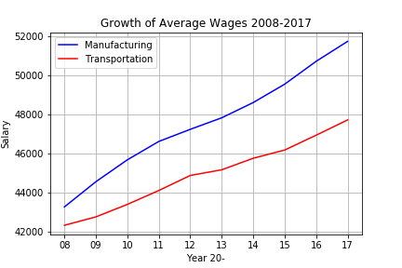
Average Annual Wages
Data:
- Annual wage information from the Bureau of Labor Statistics
Method:
- Pandas CSV read
- Matplotlib
Analysis:
- Comparison of average wages between two industries
Results:
- Stronger growth in avg. Manufacturing wages than Transportation
- Surprising statistics suggests healthy wages
Occupational Employment Statistics program, U.S. Bureau of Labor Statistics

Slide 14
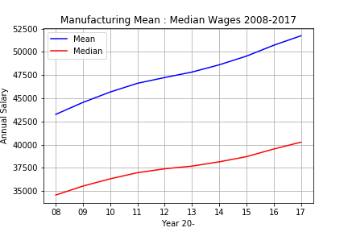
Manufacturing Wage Mean v. Median
Data:
- Annual wage information from the Bureau of Labor Statistics
Method:
- Pandas CSV read
- Matplotlib
Analysis:
- Comparison of average wages and the median wages by year
Results:
- Median flatline in the middle of dataset and slower growth
- 3% more growth in Mean Wages
Occupational Employment Statistics program, U.S. Bureau of Labor Statistics
Notes:
When we compare the mean of annual salaries to the median of the same data, we start to see a telling tale. On the Median line, near 2012, we see the data flattening. The Median is nearly unchanged for a 2-year period. Growth continues but has decelerated noticeably. We interpret this in a way that automation has displaced jobs to a new classification of unskilled work.

Slide 15
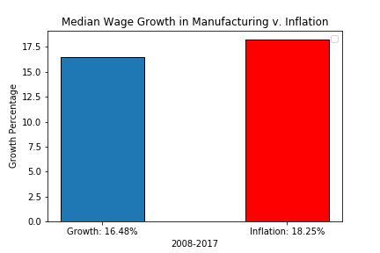
Median Wage Growth and Inflation
Data:
- Annual wage information from the Bureau of Labor Statistics
Method:
- Pandas CSV read
- Matplotlib
Analysis:
- Comparison of Median Wage Growth against Inflation
Results:
- Stagnation of Median Wage growth as slowed advancement below the rate of inflation over the past 10 years
Occupational Employment Statistics program, U.S. Bureau of Labor Statistics
Notes:
We have compared the Median Wage Growth to Inflation. The median salary in Manufacturing is not even keeping pace with inflation.

Slide 16
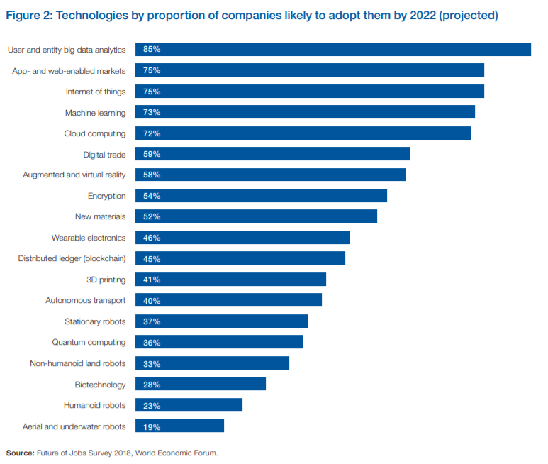
Occupations with the most job growth
“Fourth Industrial Revolution.”
WEF : 75 million jobs may be displaced over the next four years. But, 133 million additional jobs could also emerge
Threatened jobs are based on manual labor, while newer jobs require a significant investment in training.
New job roles, like data scientists, AI specialists, and human-machine interaction designer
http://www3.weforum.org/docs/WEF_Future_of_Jobs_2018.pdf

Slide 17
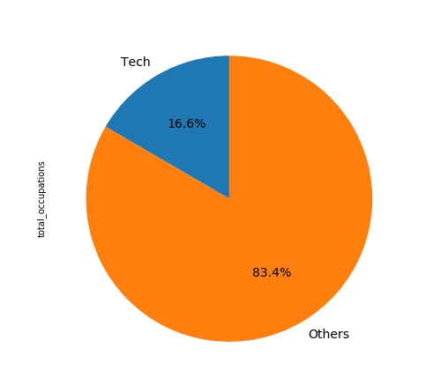
Occupations with the most job growth
Data:
Occupations with the most job growth, 2016 and projected 2026. Bureau of Labor Statistics
Method:
- Pandas/Python
- Python plotting libraries
- CSV
Occupational Employment Statistics program, U.S. Bureau of Labor Statistics
Source: Employment Projections program, U.S. Bureau of Labor Statistics

Slide 18
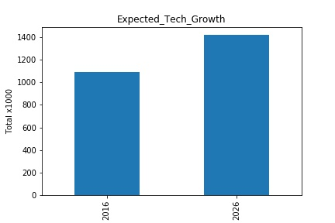
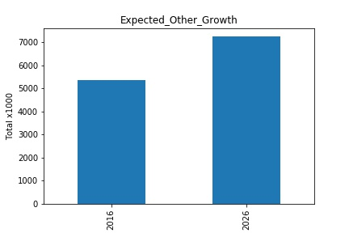
Occupations with the most job growth
Occupational Employment Statistics program, U.S. Bureau of Labor Statistics
Source: Employment Projections program, U.S. Bureau of Labor Statistics

Slide 19
Trends Unintentionally Discovered
The average wage growth in an innovatively changing industry
Labor productivity and costs right after recession vs recent years
Discordant wages vs rate of inflation
Occupations have not shifted significantly with technological advances.
Automation may change the nature of the work, but it won’t displace the workforce in masses
By automating repetitive tasks, workers are able to use more of their time for high-level activities, making them more valuable to their company.

Slide 20
If We Had Two More Weeks
Find datasets on automated processes, machine learning, and A.I.
Find employment numbers regarding specific jobs in Manufacturing.
Examine the relationship between the 10th and 90th percentile of Manufacturing wages.
Possibly add an additional sector for comparison to show differences
Analyze social media trends in the topic

Slide 21
Question Time!

Slide 22
Thank You Everyone!

